Slide 1

P peline
The Data
Byte 3
© Jennifer Mankoff & Nikola Banovic
The Data Pipeline; HCII; Spring 2017

Slide 2
Basic Hand In Expectations
Tell a story about your data.
Visualize the results (more nicely than we do!)

Slide 3
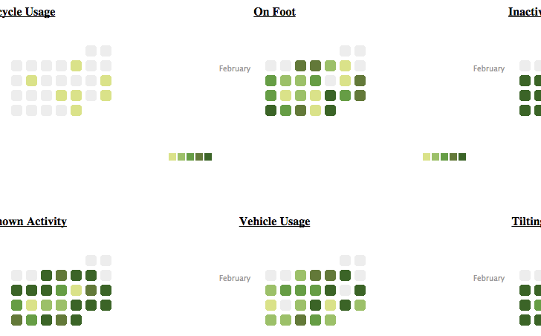
Activities by Time

Slide 4
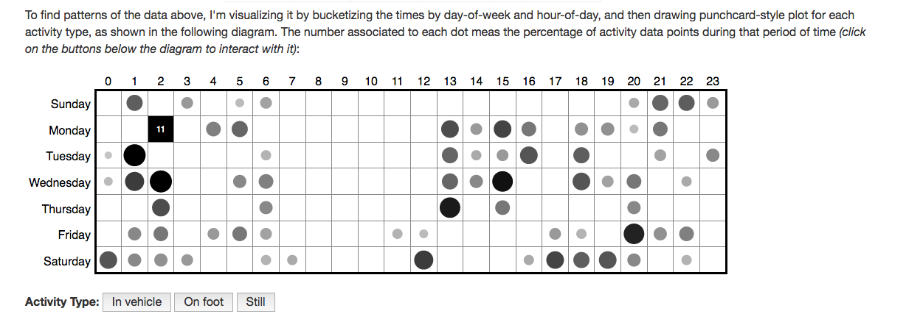
Custom Interactive Viz: Mobility by Time and Day
http://yimmy-mobile.appspot.com/

Slide 5
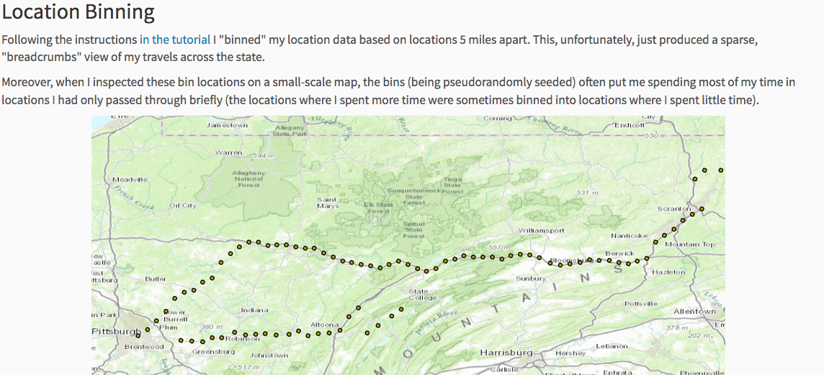
Location Binning
http://mark-where-and-what.appspot.com/

Slide 6
Byte 3
So you are done collecting your data.
Now what?

Slide 7
The Architecture Revisited
Google Cloud Platform

Slide 8
The Architecture Revisited
GCP
Appspot
SHELL
deploy
Dev
DB
Notes:
So far we used the shell to develop our apps, to test in dev server, and to deploy to the Appspot.

Slide 9
The Architecture Revisited
GCP
Appspot
PUBLIC
SHELL
deploy
Dev
DB
YOU
Notes:
And you were able to view your application on both. And public was able to see it on the app spot.

Slide 10
The Architecture Revisited
GCP
Appspot
PUBLIC
SHELL
deploy
Dev
DB
API.AWARE
YOU
Notes:
And then we introduced your phone, which communicated with api.awareframework.com to move the data to your GCP database. This is where you are now.

Slide 11
The Architecture Revisited
GCP
Appspot
PUBLIC
SHELL
deploy
Dev
DB
API.AWARE
YOU
Notes:
Now the goal is to create an application that uses the data from the DB.
You will still develop on your shell. However, you will not be able to view the app on your dev server! This is too difficult to configure and we will not ask you to do this.

Slide 12
The Architecture Revisited
GCP
Appspot
PUBLIC
SHELL
deploy
Dev
DB
API.AWARE
YOU
Notes:
Instead, you will deploy directly to appspot and test there because appspot has an ability to access the DB.

Slide 13
The Architecture Revisited
GCP
Appspot
PUBLIC
SHELL
deploy
Logging
Dev
DB
YOU
Notes:
And you will use GCP logging services (that you already tried in Byte 1) to debug your application.

Slide 14
Debugging this assignment
Server side debugging is a bit of a pain
Google helps though – provides access to logs

Slide 15
More Debugging
My helper function prints recent SQL commands to log and catches SQL query errors
You may also see errors show up in the [projectname]-byte3 browser window

Slide 16
What do can need to do with mobile data?
Cleaning: can you tell when the phone is off?
Imputing: filling in missing location readings.
Organizing: identifying common locations (what the byte walks you through)
Associating: connecting activities to other context (we explore location + activity, homework is to explore time + activity)

Slide 17
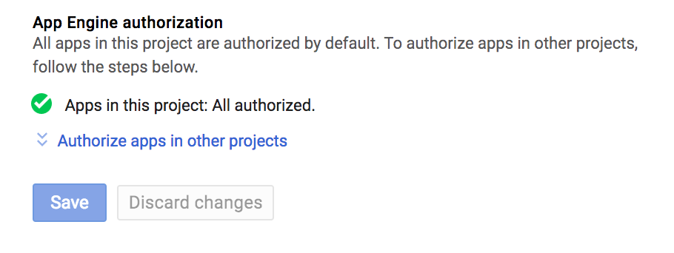
Communicating with the database
You application needs access to DB!
This is usually automatic, but I saw examples where it did not happen. You need to add your Application ID in your ”Access Control” if you do not see this:
Notes:
Otherwise just click on authorize apps and add your Application ID.

Slide 18
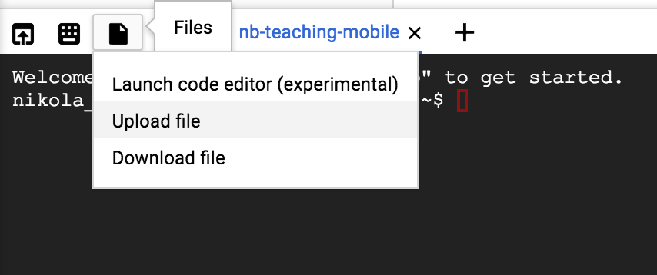
Developing Code
Start by uploading jmankoff-mobile to your Shell using the upload feature in your Shell.

Slide 19
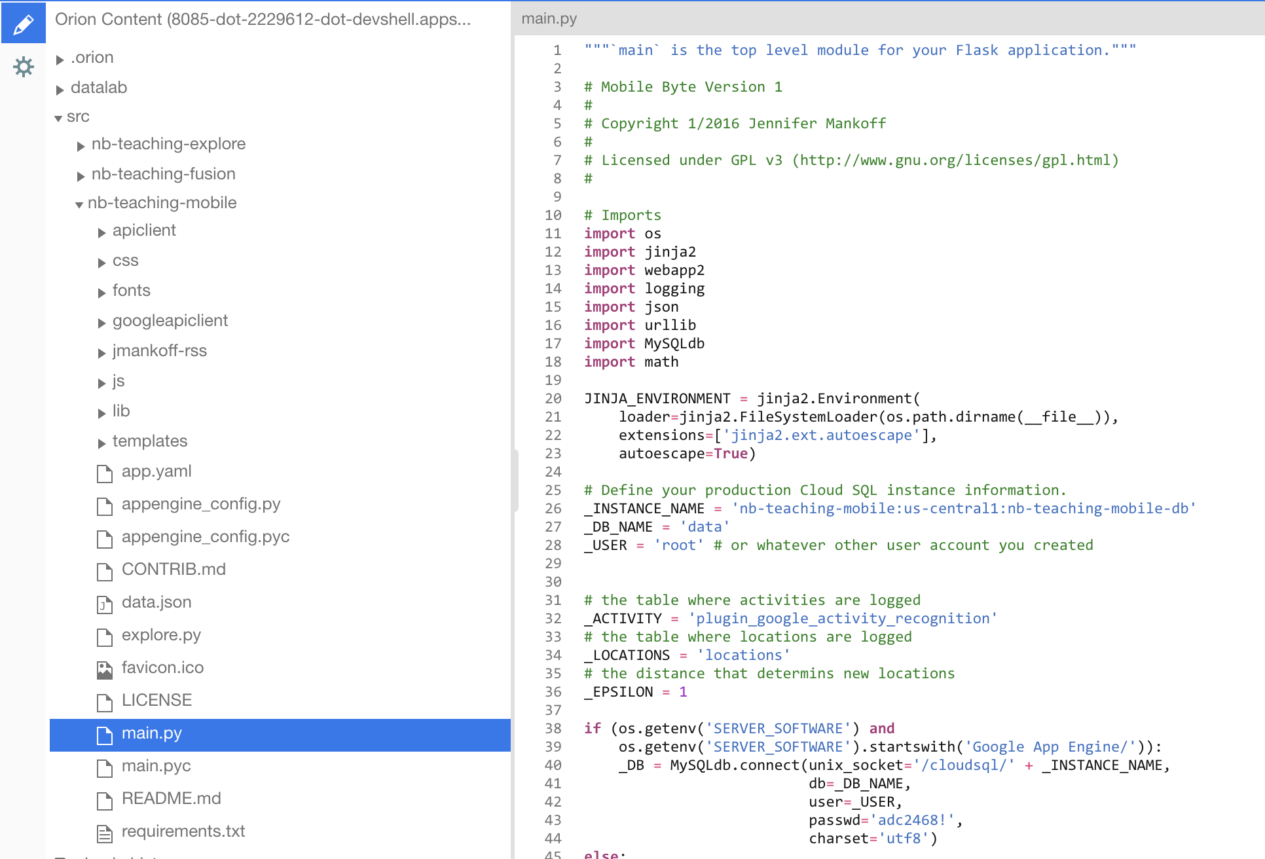
Developing Code
Once you setup the files in your document hierarchy the way you want you can start modifying the code in the Editor.

Slide 20
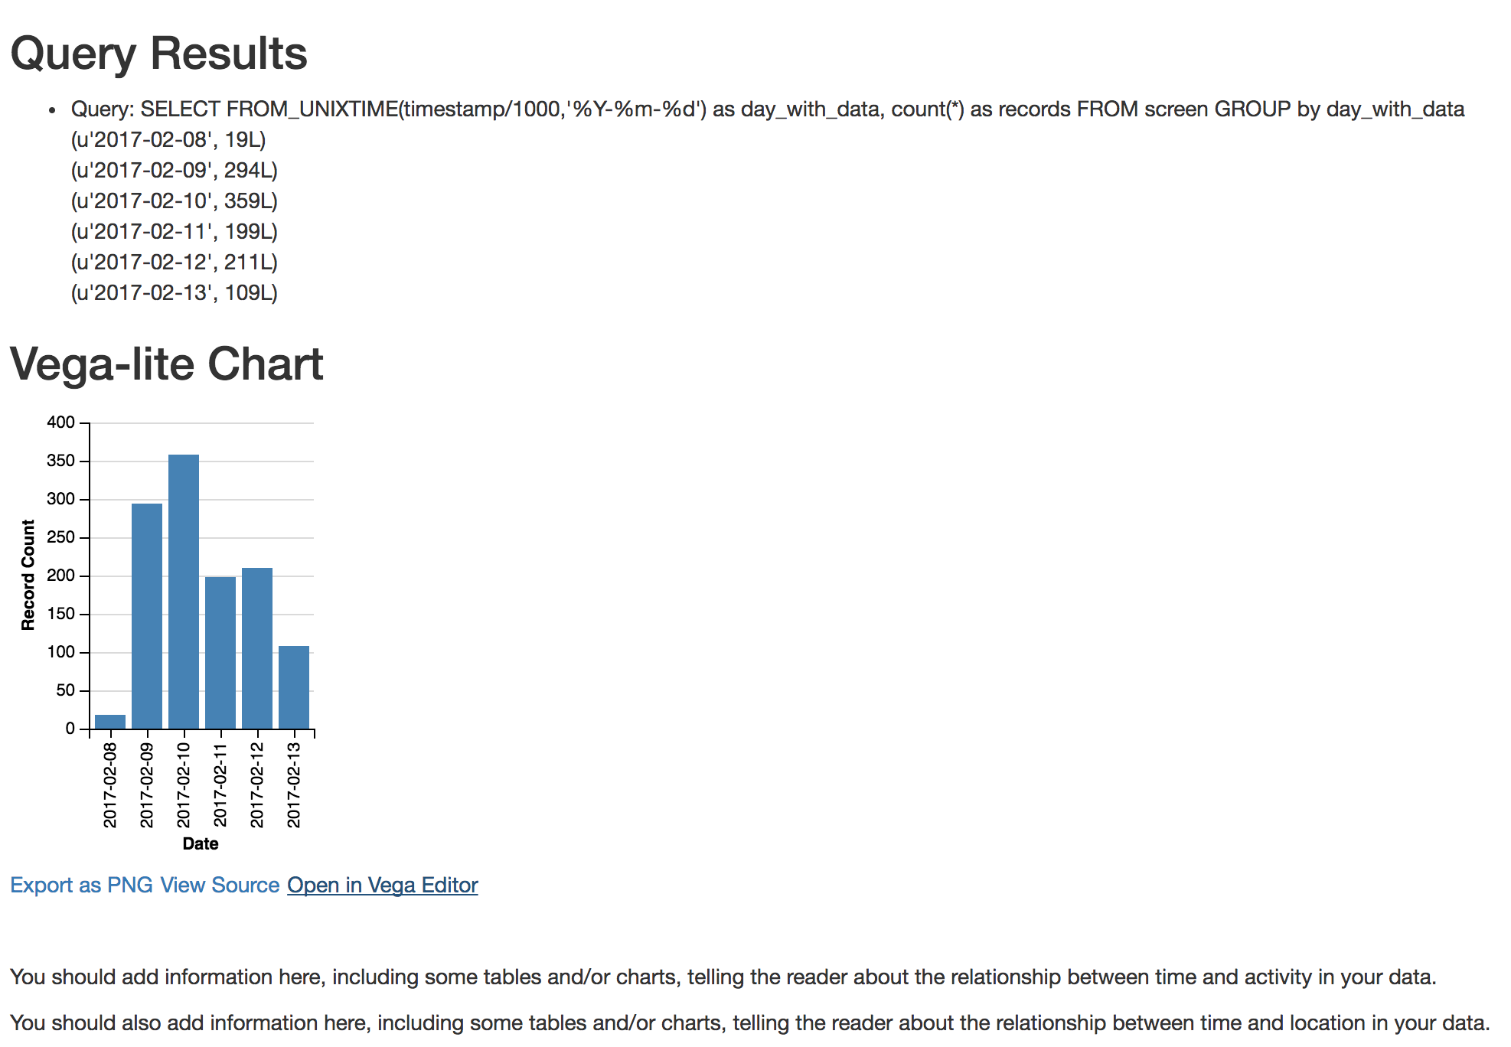
Developing Code
Deploy the code. By default, if you have location and activity data you should see:

Slide 21
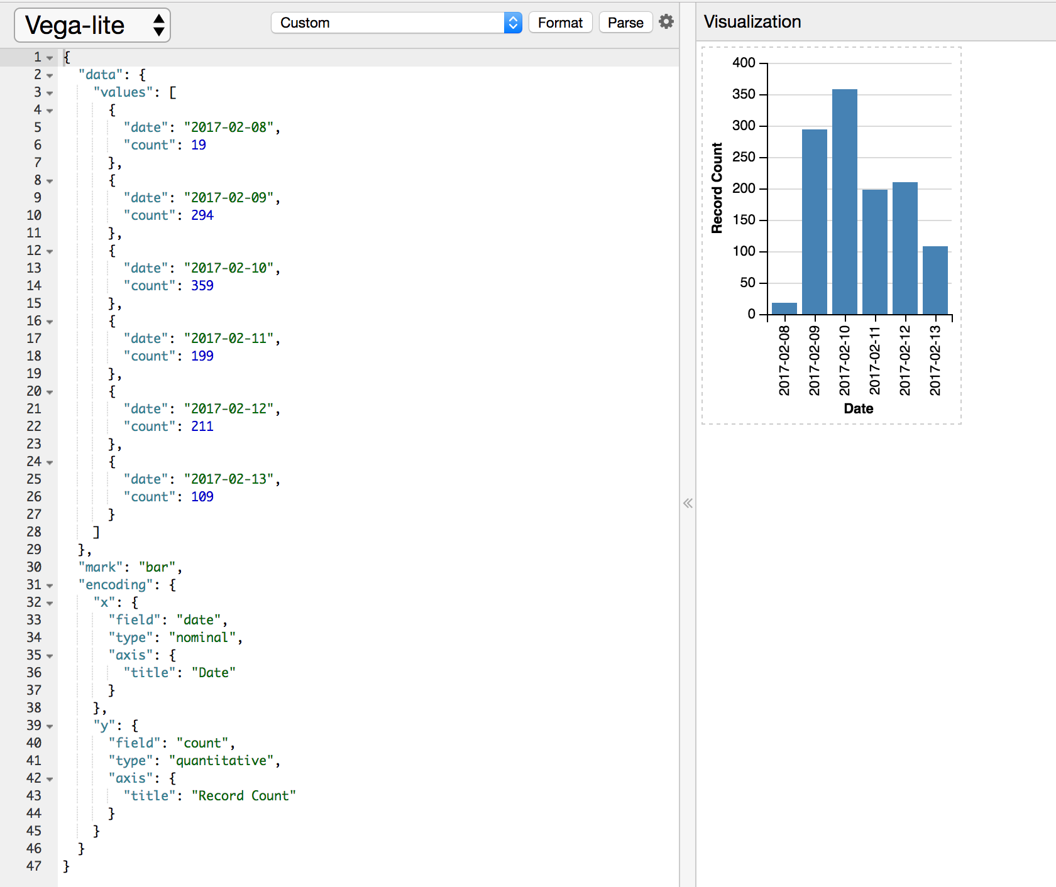
Developing Code
Vega-lite has an editor that helps you edit the JSON and see example. Click on “Open in Vega Editor” to see it.
VISUALIZATION
DATA
VISUALIZATION DEFINITION

Slide 22
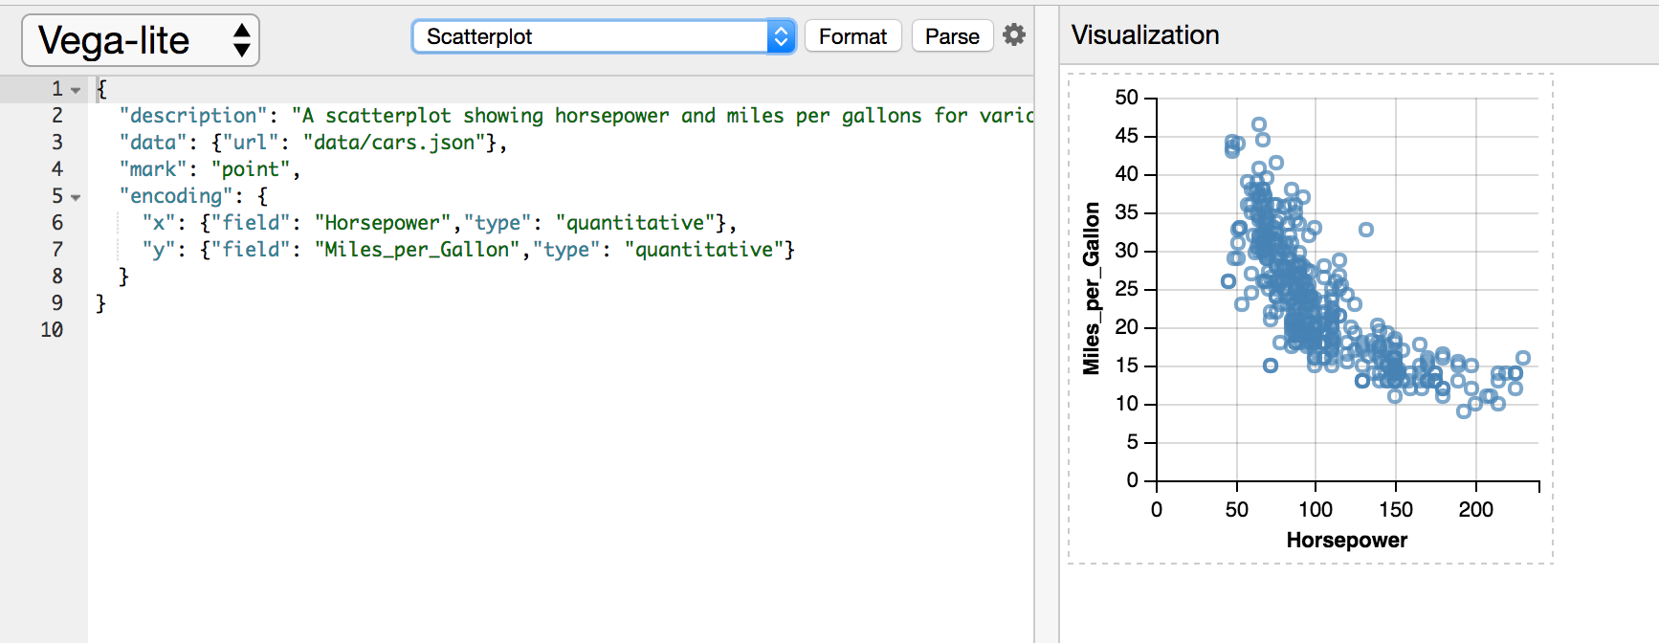
Developing Code
You can also see examples:

Slide 23
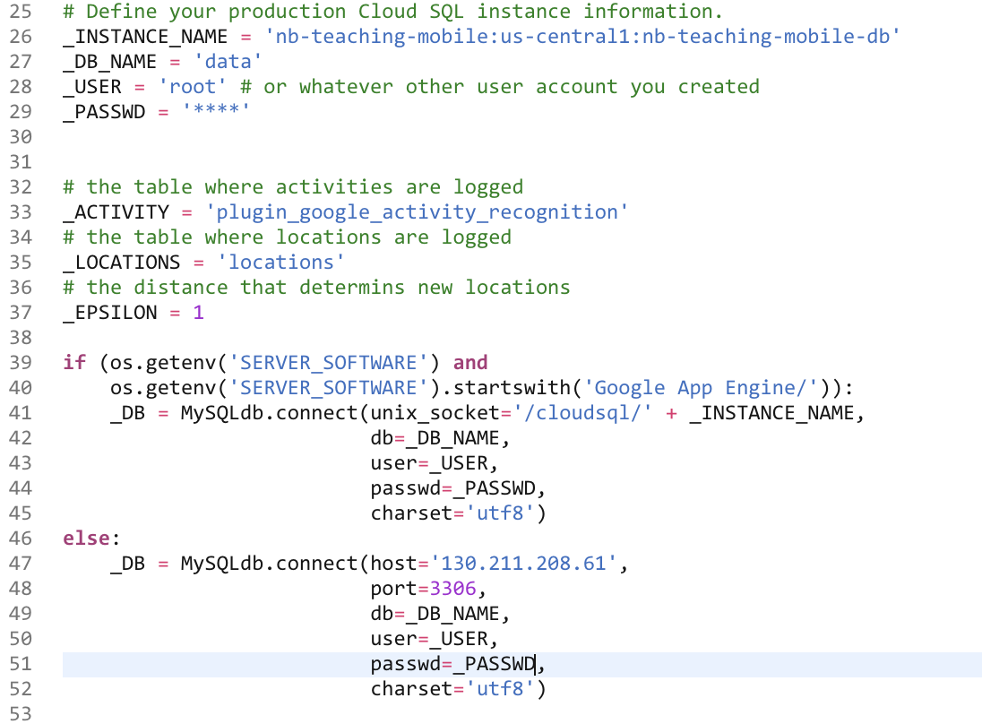
Developing Code
Connecting to the DB (main.py):

Slide 24
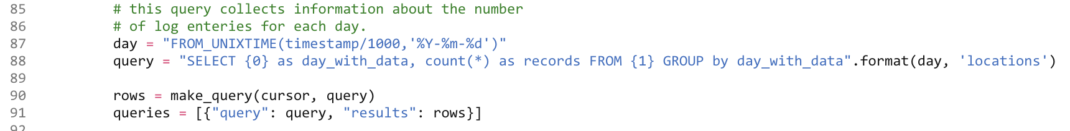
Developing Code
Making a SQL query (main.py):

Slide 25
Developing Code
Executing and passing data to the view (main.py):

Slide 26
Accessing MySQL from python
db = MySQLdb.connect(unix_socket='/cloudsql/' + _INSTANCE_NAME, db=_DB, user='root’, passwd=‘password’)
cursor = db.cursor()
Helper function – prints result to log
self.make_and_print_query(cursor, 'SHOW TABLES', 'Show the names of all tables')
Helper function – returns result as list
rows = self.make_query(cursor, query)

Slide 27
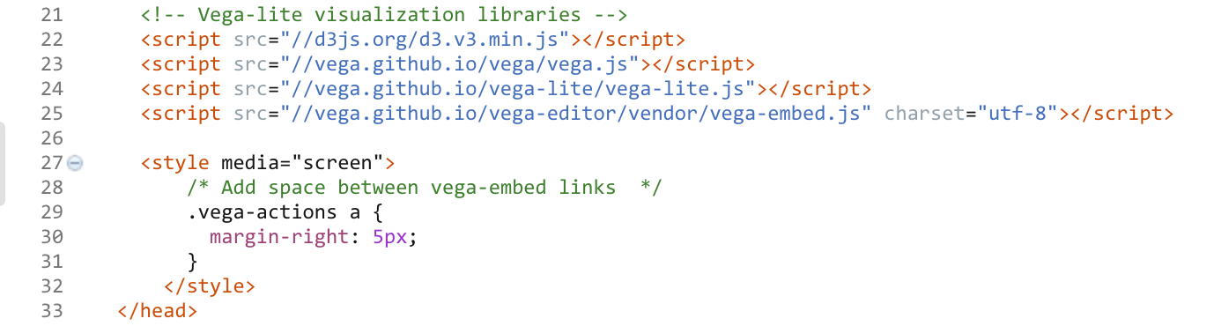
Developing Code
“Installing” Vega-lite (index.html):

Slide 28
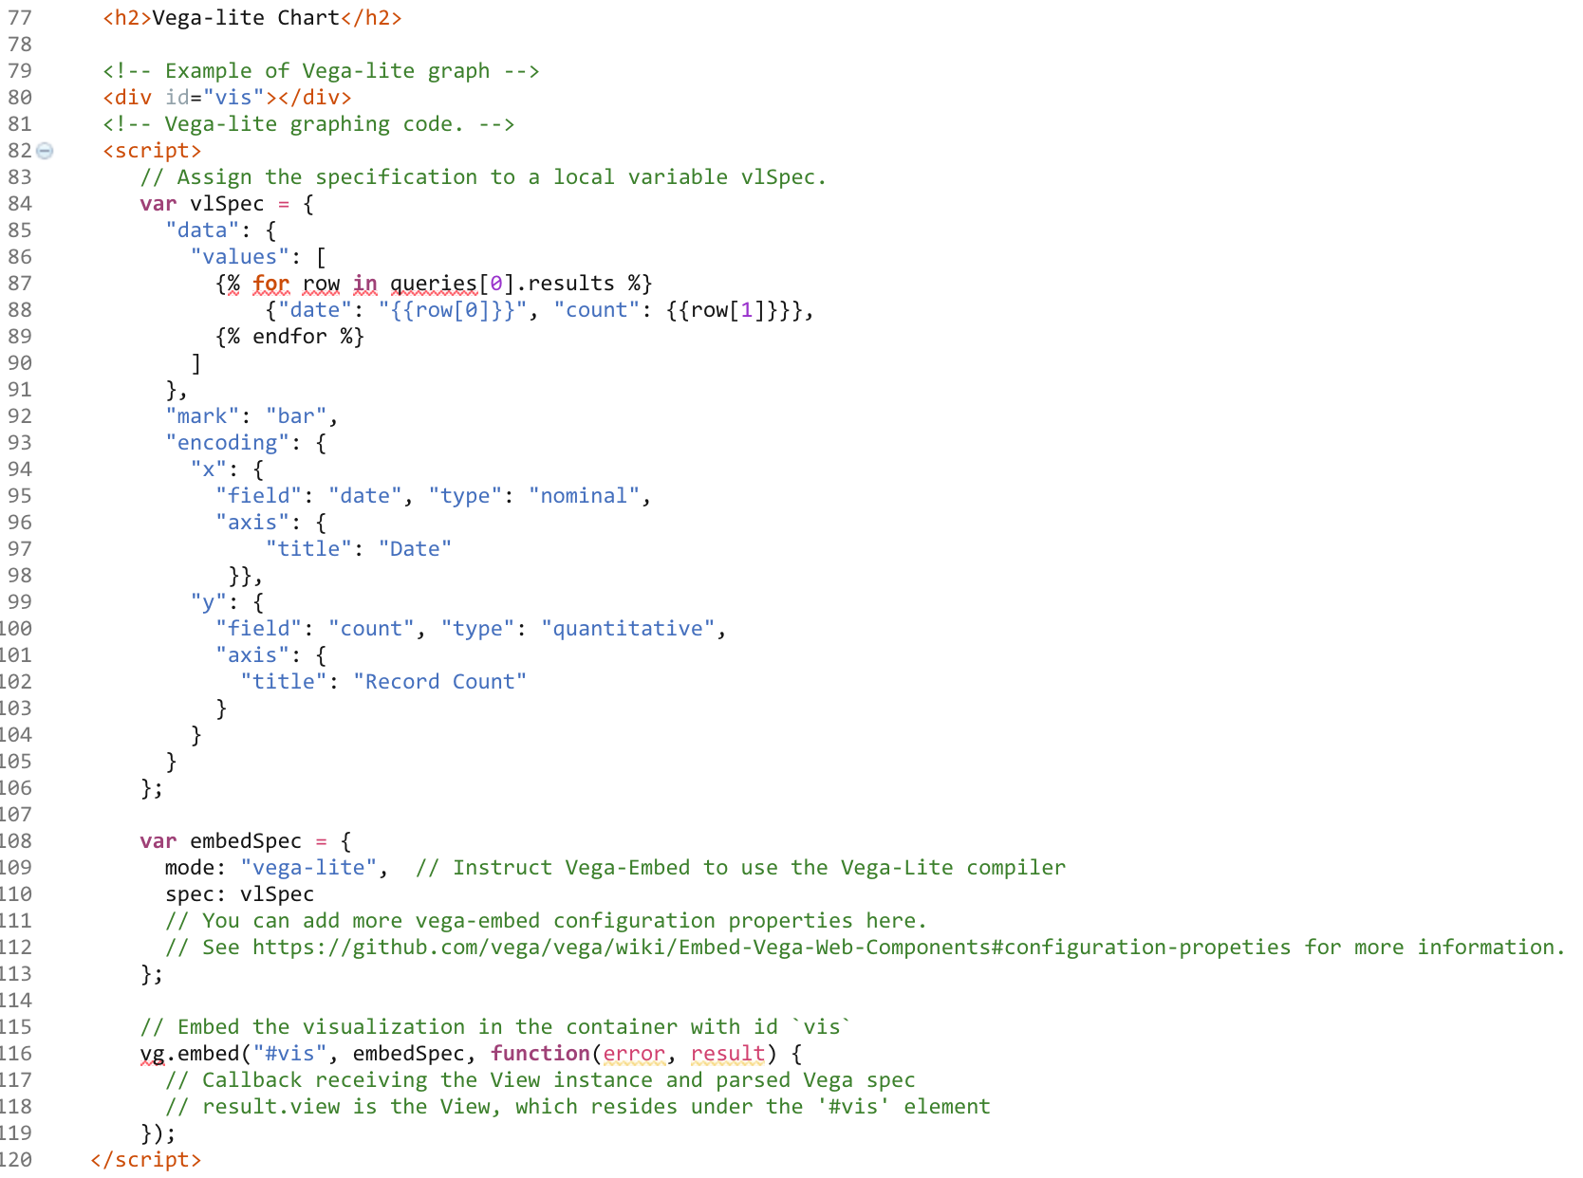
Developing Code
Displaying visualization (index.html):
<- Element to display in
<- Data and visualization specification
<- Instruct Vega-lite to display in element

Slide 29
Developing Code
If you do not like Vega-lite examples or if you don’t like changing JSON to get your chart just right, use Lyra (optional): http://idl.cs.washington.edu/projects/lyra/app/

Slide 30
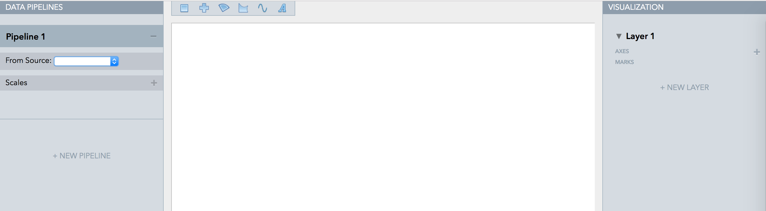
Developing Code
Lyra is an interactive environment that enables custom visualization design without writing any code.
<- Load your data source

Slide 31
Developing Code
Lyra is an interactive environment that enables custom visualization design without writing any code.
A great demo at:
https://vimeo.com/96104443

